Slide 1
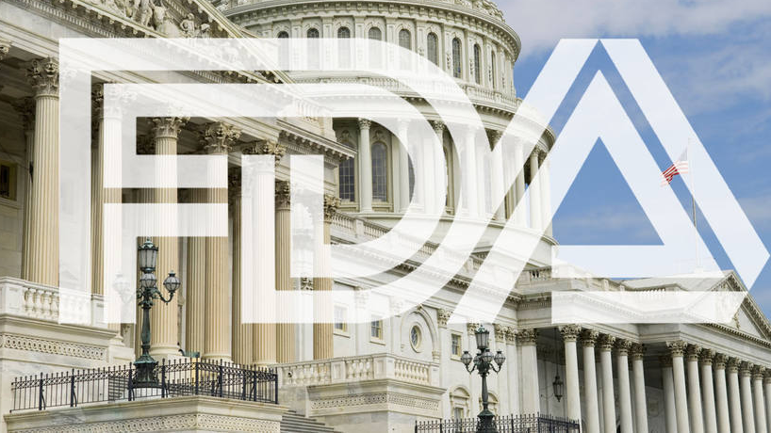
OneScan
https://www.cigaraficionado.com/article/lobbyists-increase-outreach-for-premium-cigar-exemption-19574

Slide 2

ENGG6400 Mobile Devices App Development
Group 5 Zimo Zhou (1189792), Yaowen Mei (1177855)

Slide 3
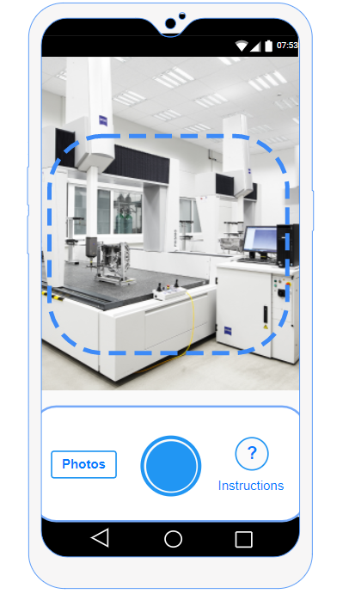
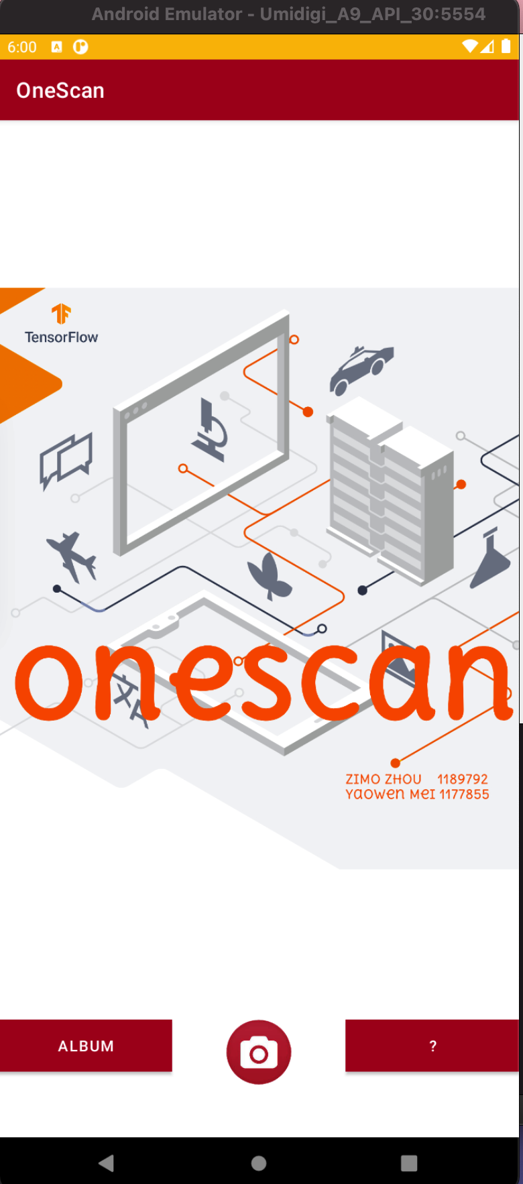
Mock-up vs Real
--- Home Screen
User can take a picture with this app
Or choose a photo from the album
Or see the instructions about how the app is going to work
3
1
2

Slide 4
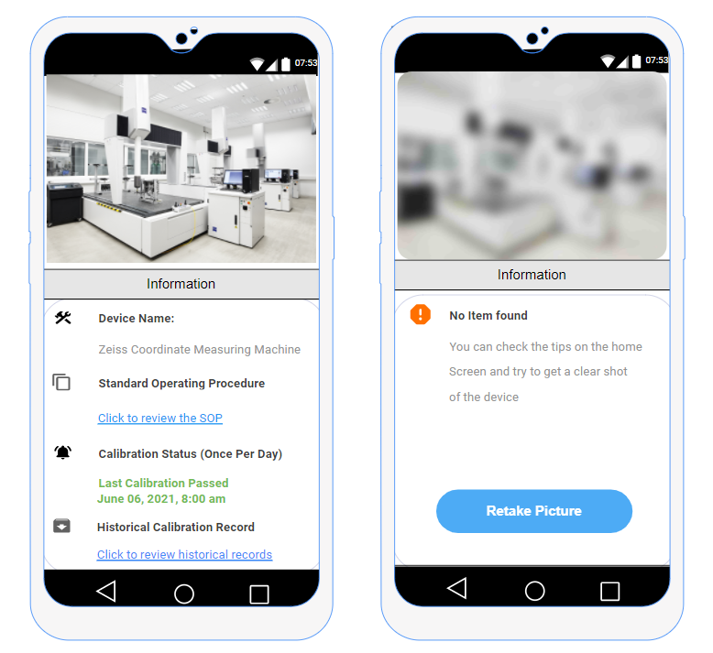
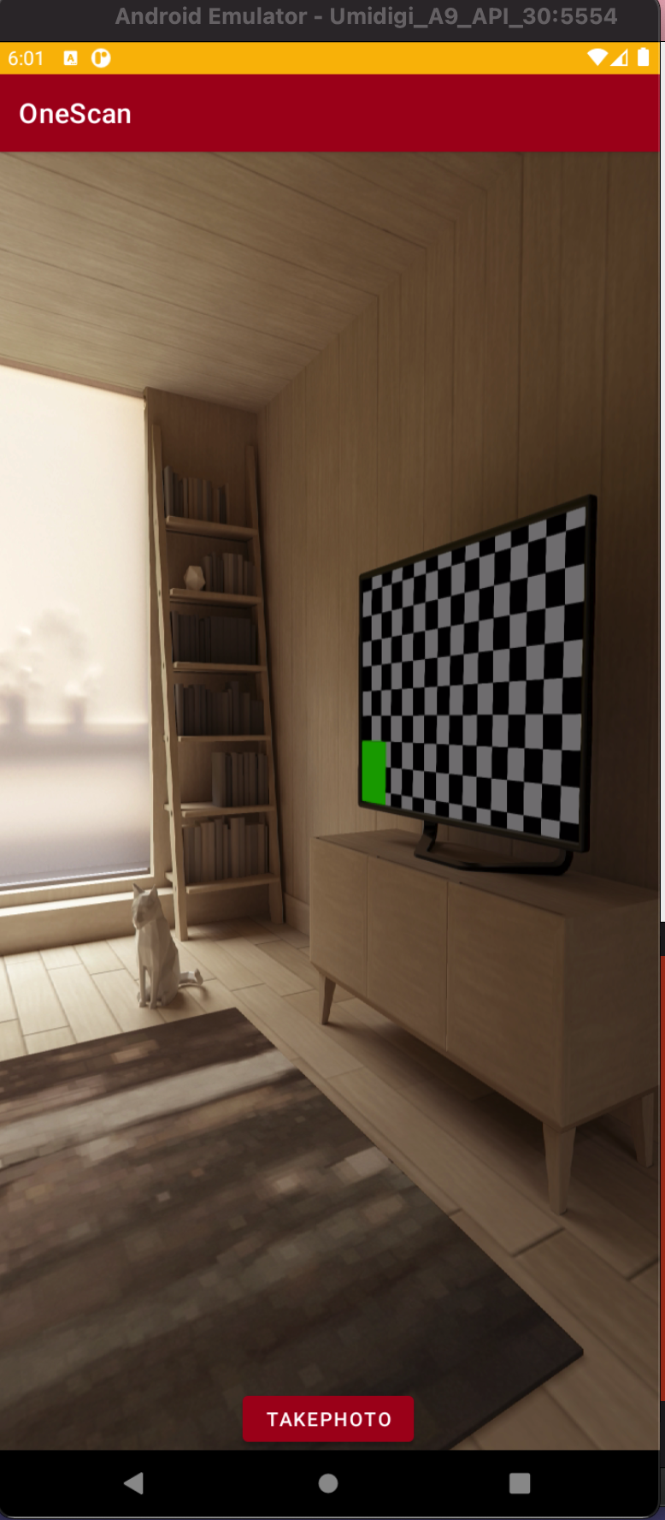
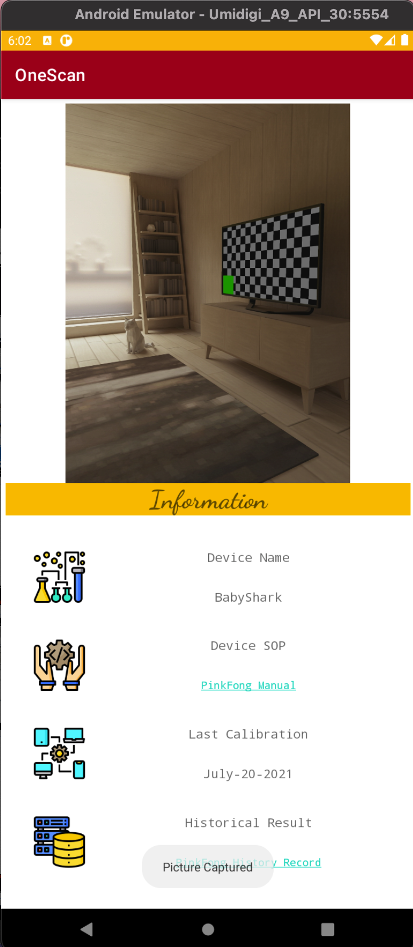
Mock-up vs Real
--- 1) Take a picture
If the device is recognized, the calibration information of this device will then be generated from the data base. Green for good to use, Red for out of calibration
If the picture is blurry, device can not be recognized, an error message will be generated, so user can retake the picture

Slide 5
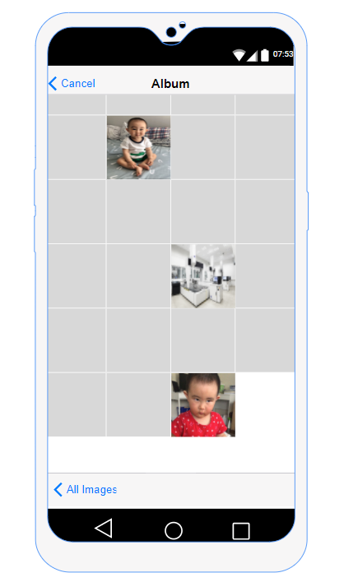
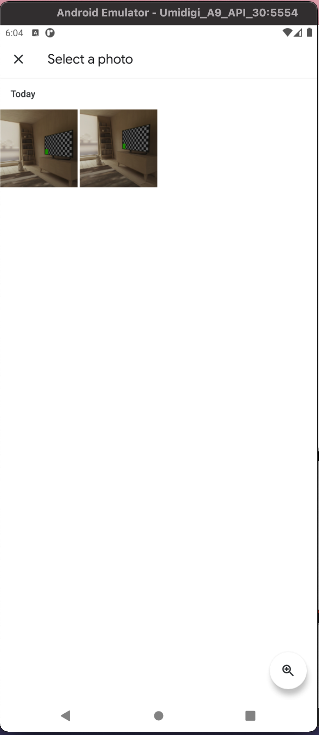
Mock-up vs Real
--- 2) Select from Album
User can also take pictures from the album

Slide 6
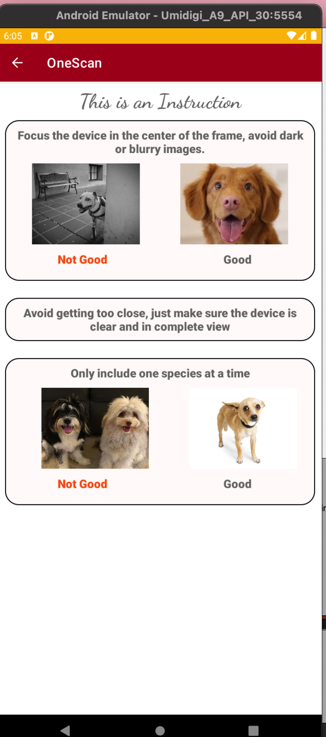
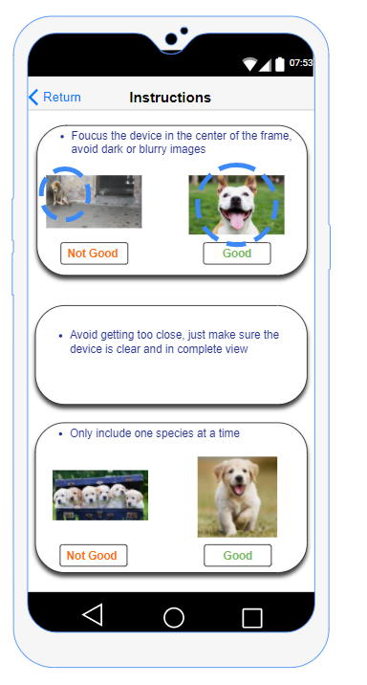
Mock-up vs Real
--- 3) Instruction
The user should be able to use this app by intuition, but just in case, some instructions are aslo provided for the user:
Focus and put target in the center
Only picture one object at a time

Slide 7
Block Diagram
D
Home Screen
Done
3
2
1
Select Image from Album
Take a picture
Show Instruction
Picture Clear
Blurry
Retake Pic
Need to
Be Done
Get Status from Tensor flow and Database

Slide 8
The End. Thank you!

